Slide 1

THE BATTLE OF ORIGINS!
Lesson #8
Science and the Age of the Earth

Slide 2
Science and the Age of the Earth
In our last lesson we saw that the evidence
in the Bible shows the earth is very young, around 6,000 years old.
As we look at the science concerning the age of the earth we are not going to come up with an exact age but we will see that the evidence points to an earth that is thousands of years old and not billions of years old!
When scientific evidence about the age of the earth is looked at objectively we will see that the conclusions goes against what we are
told by those who believe in evolution.

Slide 3
Science and the Age of the Earth
When we read Genesis chapter 1, we see that it speaks of creation taking place in six days with God resting on the seventh day.
We know the Bible is true but most people find it hard to believe the whole universe could be brought into existence in 6 days, especially since they have been bombarded with what evolutionist present as facts!

Slide 4
Science and the Age of the Earth
Though it may seem like all scientist believe in evolution, there are some who believe that the earth is young (thousand of years not billions) and they look to science to prove it.
Those scientists who believe in a young earth
do not consider themselves to be anti-scientific or anti-intellectual. They are simply following
the scientific evidence to its logical conclusion.

Slide 5
Science and the Age of the Earth
There are also organizations of scientists who are young-earth creationists in at least ten different countries, as well as in many areas
in this country.
Creation scientists say the difference between them and evolutionist is this…
We believe the Bible must take priority over
scientific theories, while evolutionist believe
scientific theories must determine our Biblical
interpretations.
Notes:
Old-Earth Creationism, by Henry M. Morris, Ph.D.

Slide 6
Science and the Age of the Earth
Evolution has been taught as “scientific fact”
for so long that it is deeply entrenched in the
minds of people and is a difficult challenge
to change that concept, but we need to begin somewhere. Let it begin with us!
If people would honestly and sincerely consider the evidence they would see the truth that the world is young!
Let’s look at some of the scientific evidence that shows that fact to be true!

Slide 7
Science and the Age of the Earth
POPULATION STATISTICS
The study of population statistics is a strong argument for a young earth.
Population growth can be determined by using formulas that give a reasonable answer to future population numbers.
The formula is….
Notes:
The Young Earth, by Bert Thompson, Ph.D.

Slide 8
Science and the Age of the Earth
Pn = 2/(C-1) (Cn-x+1) (Cx – 1)
Pn = population after n generations
n = number of generations
x = life span of generations
2c = number of children per family
Evolutionists say that mankind has been on
the earth about 2-3 million years. By using conservative numbers for our formula it
gives us a population number of…
Notes:
The Young Earth, by Bert Thompson, Ph.D.

Slide 9
Science and the Age of the Earth
1 x 105000 = population of the earth
That is a 1 followed by 5,000 zeroes!
There is no way that the earth could hold that many people!
In fact, it has been calculated that the Universe is about 20 billion light years in diameter and even as big as that is, the Universe could not hold the number of people that is calculated
by the formula for even 2 million years!
Notice the following chart…
Notes:
The Young Earth, by Bert Thompson, Ph.D.

Slide 10
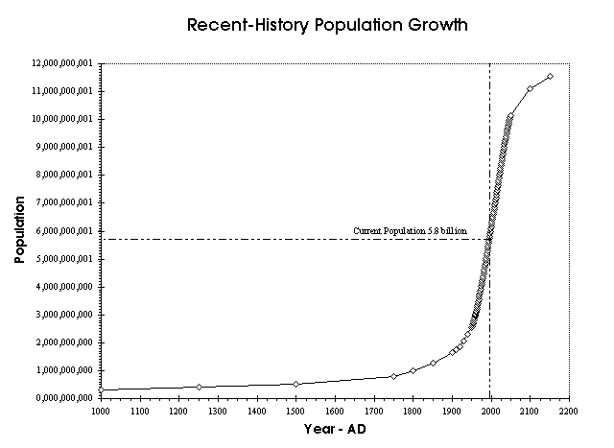
Notes:
The Young Earth, by Bert Thompson, Ph.D.
In the year 1,000 there were about 300,000,000 (300 million) people on the whole earth.
Today, just in the United States, there are over 314,000,000 (314 million) people!
Notice that at some point the population grows at a rapid rate, see about 1950 AD.

Slide 11
Science and the Age of the Earth
The worlds population growth…
1805 – 1 billion people!
1927 – 2 billion people!
1959 – 3 billion people!
1974 – 4 billion people!
1987 – 5 billion people!
1999 – 6 billion people!
2011 – 7 billion people!
2025 – 8 billion people?
2050 – 10 billion people?
2100 – 11 billion people?
Notes:
The Young Earth, by Bert Thompson, Ph.D.
Note: According to the now-prevailing view, the first humans lived over two million years ago. If that is really so, where are all the trillions upon trillions of people who should either be alive, or whose buried remains, potentially fossilized, should be found in vast graveyards scattered around the world?
Answer: they are nowhere to be found because they never existed!
The statistics on the following slides were written in about 2010.

Slide 12
Science and the Age of the Earth
In 1650 AD. the world’s population was about 600 million people. By the year 1950 it was about 2,400 million people.
That means that the worlds population doubled twice in 300 years, at an average rate of once every 150 years.
Currently the worlds population is doubling at a faster rate than every 150 years.
Notice the chart once again….
Notes:
See, http://creation.com/human-population-growth written about 2010.
600 million – doubled in 150 years = 1,200 million people
1,200 million – doubled in 150 years = 2,400 million people

Slide 13
Notes:
The Young Earth, by Bert Thompson, Ph.D.
As the earth’s population increases the population doubles at a faster rate than it has in the past.
We can see from the chart that the population did not grow very fast until around 1950 then it has really taken off!
This is the population that resulted from the time of Adam and Eve about 6,000 years ago, then was reduced in the Flood when only Noah’s three sons and their wives had children.
If mankind had been around for about 2 million years the population would be something like 1 followed by 5,000 zeros, which is impossible!
This is proof that mankind has not been around for millions of years!

Slide 14
Science and the Age of the Earth
Population growth is currently increasing at a rate of approximately 1.8% per year, or doubling every 39 years.
The worlds population has doubled 31 ½ times since humans first appeared on earth.
By taking earth’s current population and then calculating backwards we see that mankind appeared on earth about 6,500 years ago.
That is about what we calculated the age of the earth to be in our last lesson by using the genealogies of the Bible!
Notes:
See, http://creation.com/human-population-growth written about 2010.
We said that the earth was roughly 6,000 years old.
Present time back to Jesus = 2000 years
Jesus back to Abraham = 2000 years
Abraham back to Adam = 2000 years
For a total of = 6000 years since earth began
So we see that population statistics support the chronology found in the genealogies of the Bible!

Slide 15
Science and the Age of the Earth
By using the population formula and the Bible’s timeline we find that the current population of the world comes out to be about 7-8 billion people!
Which is exactly what we have, 7.5 billion people in the world today!
This proves that the creationist model which says the earth is only a few thousand years old is true!
THE CHRONOLGY OF
GOD’S WORD IS TRUE!
Notes:
Also see, http://creation.com/human-population-growth written about 2010.
The world’s current population is 7.5 billion people in the year 2017.
Next let’s look at Earth’s Magnetic Field…..

Slide 16
Science and the Age of the Earth
EARTH’S MAGNETIC FIELD
There are three important force fields associated with planet Earth—gravitational, electric, and magnetic. The magnetic field is due to the huge electric current, billions of amperes worth, circulating through the core of the Earth.
If you have ever used a compass to find which way is North you have used the earth’s magnetic field.
Notes:
The Young Earth, by Bert Thompson, Ph.D. Page 3

Slide 17
Science and the Age of the Earth
Also, if you have ever seen the Aurora Borealis (Northern Lights) you have seen the magnetic field at work.
Free electrons and protons are thrown from the sun's atmosphere and blown towards the earth by the solar wind, the charged particles are largely deflected by the earth's magnetic field.
However, the earth's magnetic field is weaker at either pole and therefore some particles enter the earth's atmosphere and collide with gas particles causing the beautiful light displays.
Notes:
The Young Earth, by Bert Thompson, Ph.D. Page 3

Slide 18
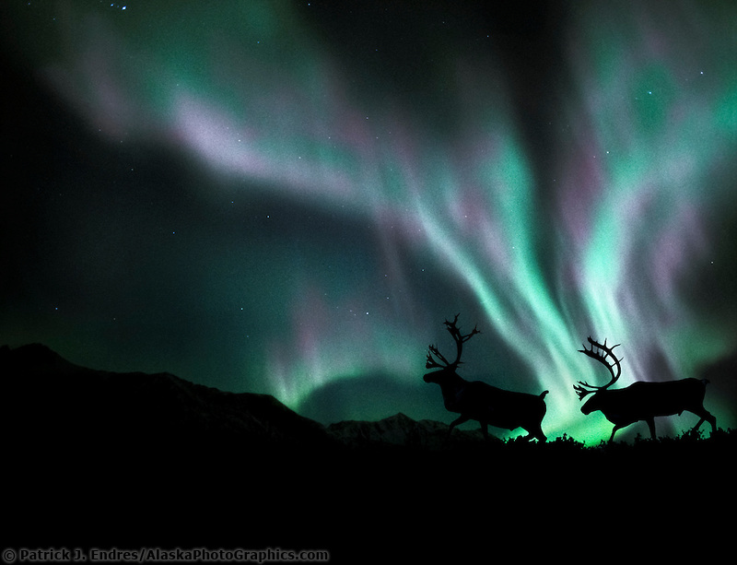

Slide 19
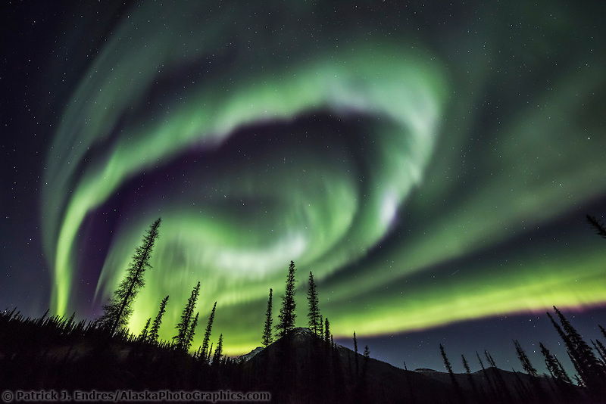

Slide 20
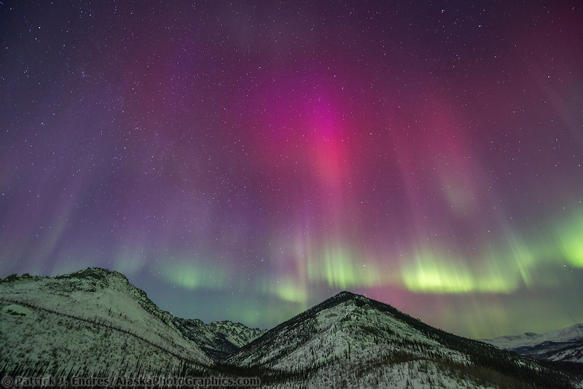

Slide 21
Science and the Age of the Earth
The main purpose of the earth’s magnetic field is to protect us and keep our atmosphere intact.
Without the protection of the magnetic field,
the steady pressure of the solar wind would gradually vaporize the upper reaches of the Earth's atmosphere until little air is left.
Planets without strong magnetic fields tend
to lose their atmospheres to space.
That is why the magnetic field is so important
to life on earth!
Notes:
The Young Earth, by Bert Thompson, Ph.D. Page 3

Slide 22
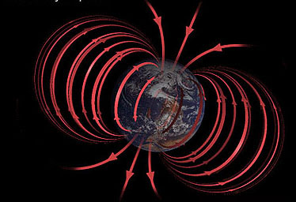

Slide 23
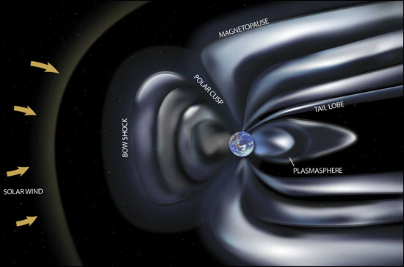

Slide 24
Science and the Age of the Earth
It is a known fact that the earth’s magnetic field
is rapidly decaying. By using the rate of decay,
a government report estimates that the magnetic field will be gone by the year 3991 A.D.
If we use the known rate of decay and reverse the calculations we can determine the strength
of the earth’s magnetic field in the past.
What has been determined is that by going back-ward for more than a few thousand years the magnetic field becomes so strong that the earth could not sustain itself and would rupture.
Notes:
The Young Earth, by Bert Thompson, Ph.D. Page 3

Slide 25
Science and the Age of the Earth
Thomas G. Barnes, late professor emeritus of physics at the University of Texas at El Paso, calculated the upper limit of this time span to
be 10,000 years.
By studying the earth’s magnetic field we see
that science points to a young earth of less
than 10,000 years, not billions of years as
taught by evolutionist!
The Bible’s Timeline Is True!
Notes:
The Young Earth, by Bert Thompson, Ph.D. Page 3
Isn’t that interesting? We have learned that the earth is about 6 thousand years old. (see lesson 7)
Yet, the evolutionist want us to believe that earth is about 5 billion years old, which according to the science of the magnetic field could not happen!
Therefore, we see that the Bible’s Timeline is….

Slide 26
Science and the Age of the Earth
POLYSTRATE FOSSILS
One of the arguments that evolutionist use to show that the earth is ancient is the sedimentary rock layers that are seen all around the planet.
The formation of these sedimentary rock layers
is called stratification or layered sequence. The layers are commonly called strata.
We can easily observe these layers of rock as
we drive along Highway 65 here in the Hollister, Branson area!
Notes:
The Young Earth, by Bert Thompson, Ph.D. Page 3-4
Here in Ozark Mountain Country we have a lot of roadways that have been cut out of rock and has exposed these rock layers for us to see!

Slide 27
Science and the Age of the Earth
Evolutionist tell us that these layers of rock came about as layer upon layer piled on top of one another gradually over vast periods of time
and formed the rock that we see today.
Here are some pictures that show the layering
of rock or strata…
Notes:
The Young Earth, by Bert Thompson, Ph.D. Page 3-4

Slide 28
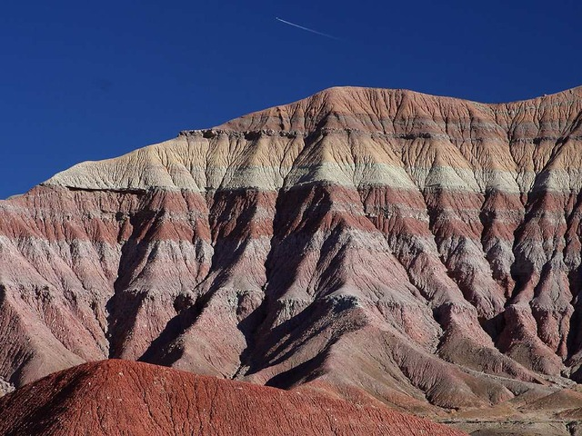

Slide 29
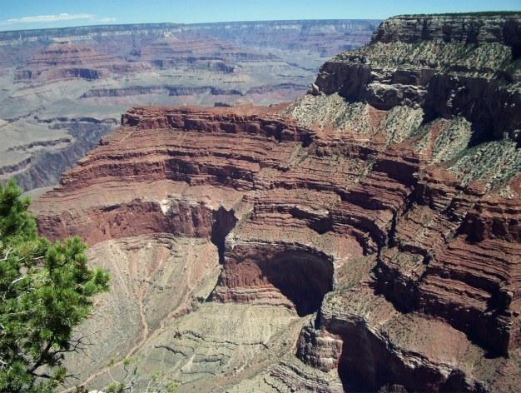

Slide 30
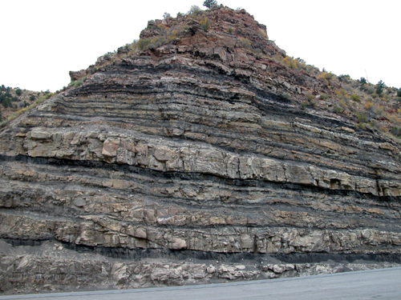
Notes:
Very similar to what we see along our highways!

Slide 31
Science and the Age of the Earth
Evolutionist tell us that these layers of rock gradually formed over millions of years.
Creationist, on the other hand, say that the rock layers formed suddenly over a short period of time.
One of the best proofs that these rock layers formed suddenly, and not gradually over millions of years, is found in a fossil called a ‘polystrate fossil.”
Notes:
The Young Earth, by Bert Thompson, Ph.D. Page 4

Slide 32
Science and the Age of the Earth
A polystrate fossil refers to a fossil that cuts through at least two sedimentary rock layers
and one of the most recognized of the polystrate fossils are tree trunks!
These tree trunks are found extended vertically through two or more strata of rock that were supposedly laid down over a period of millions of years.
The big problem with this theory is that wood exposed to the elements would rot before it
was fossilized!
Notes:
The Young Earth, by Bert Thompson, Ph.D. Page 4
Here is a picture of a polystrate fossilized tree trunk…

Slide 33
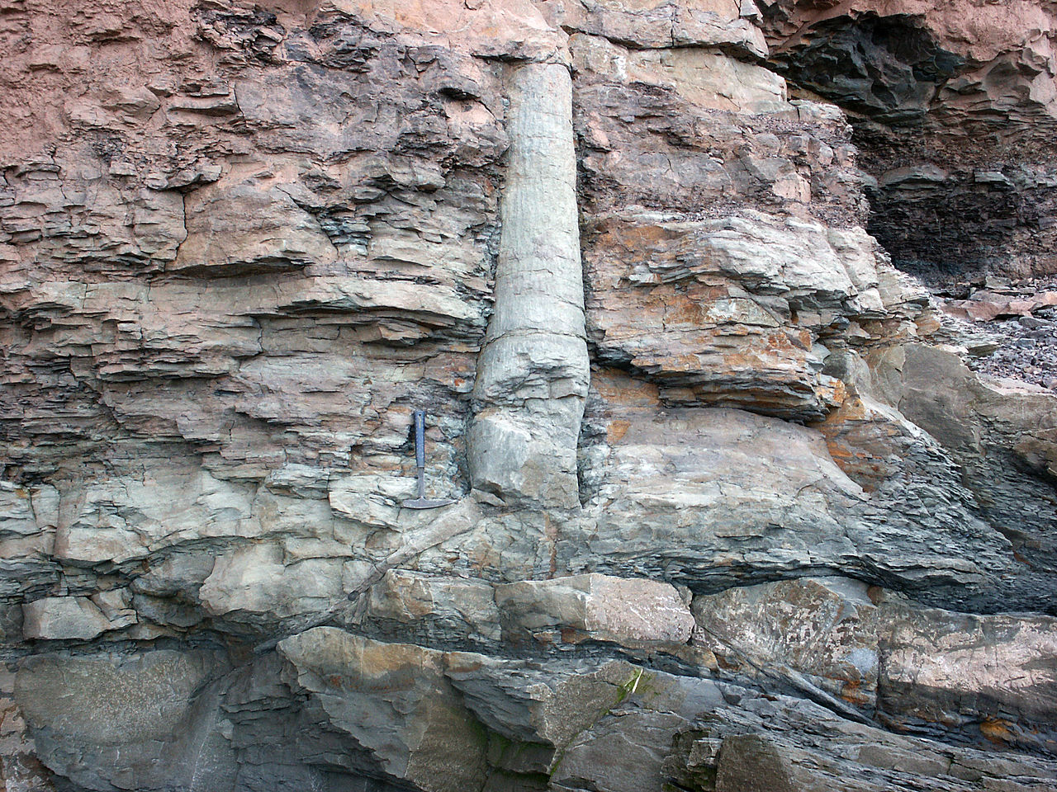
Notes:
https://en.wikipedia.org/wiki/Polystrate_fossil#/media/File:Lycopsid_joggins_mcr1.JPG
Notice the tree trunk going through several layers of sedimentary rock and the root just below the hammer.

Slide 34
Science and the Age of the Earth
The tree trunks have been fossilized which means they must have been preserved rather quickly, otherwise they would have decayed!
This also suggest that the sedimentary layers surrounding them must have also been formed quickly!
It has been stated, “They constitute a sort of frozen time clock from the past, indicating that terrible things occurred—not over millions of years but very quickly” over a short period of time.
Notes:
The Young Earth, by Bert Thompson, Ph.D.
By Paul Ackerman, (1986, p. 84; see also Morris, 1994, pp. 100-102; Wilson, 1997, 1:37-38).

Slide 35
Science and the Age of the Earth
What is it that could have suddenly happened
in the past that would have formed the layers
of rock and buried the tree trunks so they would fossilize instead of decay?
THE FLOOD!
Notes:
The Young Earth, by Bert Thompson, Ph.D.
Most scientists today do not even consider the Flood of Noah when they looking at rock and fossil formation.
We will discuss this more in our next lesson.
They believe in uniformitarianism which states that everything happened gradually over a long period of time.
Sadly, they are wrong and this way of thinking distorts their conclusions.
Next let’s look at oil and natural gas pressure….

Slide 36
Science and the Age of the Earth
OIL AND NATURAL GAS PRESSURE
Have you ever seen one of the movies that depicted explorers striking oil and it gushed
out of the ground like a geyser?
Do you remember back in 1990-1991 when Saddam Hussein, President of Iraq, invaded
the country of Kuwait and blew up their oil wells?
The oil wells became flame torches as the oil spewed out of the ground!
Notes:
http://www.nelsonprice.com/how-old-is-the-earth/
Here are a few pictures….

Slide 37
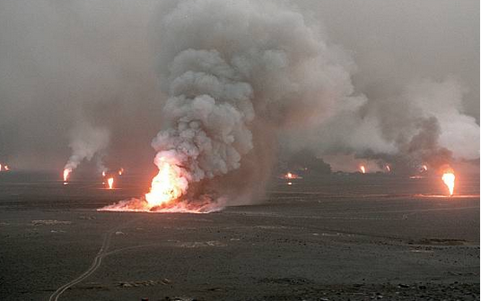
Notes:
Burning oil field in Kuwait.

Slide 38
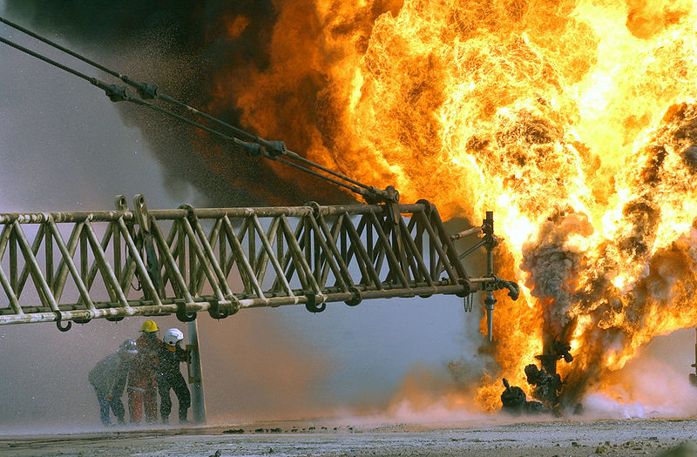
Notes:
Firefighters fight to secure a burning oil well in the Rumaila oilfields in Kuwait.

Slide 39
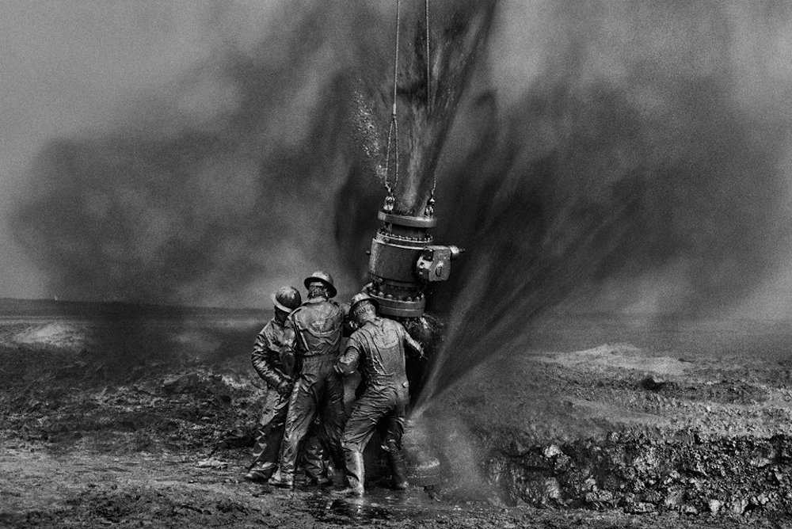
Notes:
American contractors capping off one of the oil wells in Kuwait after the invasion of Iraq in 1990-1991.
Notice the pressure of the oil coming out of the ground.

Slide 40
Science and the Age of the Earth
Why did the oil gush out of the ground like that?
Because it was under great pressure!
All of this oil had been trapped beneath the sedimentary rock under great pressure.
As you know, sedimentary rock is porous and after millions of years the pressure from these vast oil fields should have leaked off and the
oil should not gush out of the earth like it does!
Notes:
http://www.nelsonprice.com/how-old-is-the-earth/

Slide 41
Science and the Age of the Earth
Discoveries of oil and gas have shown us that they are under high pressure below the surface of the earth.
If those oil deposits had been there for millions of years as evolutionist tell us, based on the porous nature of the soil, the pressure should gone or greatly reduced.
But if the oil wells were only about 5,000 years old then you would expect the pressure of these wells to be high as we have see today.
All of this suggest a young earth!
Notes:
http://www.nelsonprice.com/how-old-is-the-earth/
Hydrogen points to a young earth….

Slide 42
Science and the Age of the Earth
HYDROGEN IN THE UNIVERSE
Hydrogen is a chemical element with the symbol H and an atomic number 1 and is the lightest element on the periodic table.

Slide 43
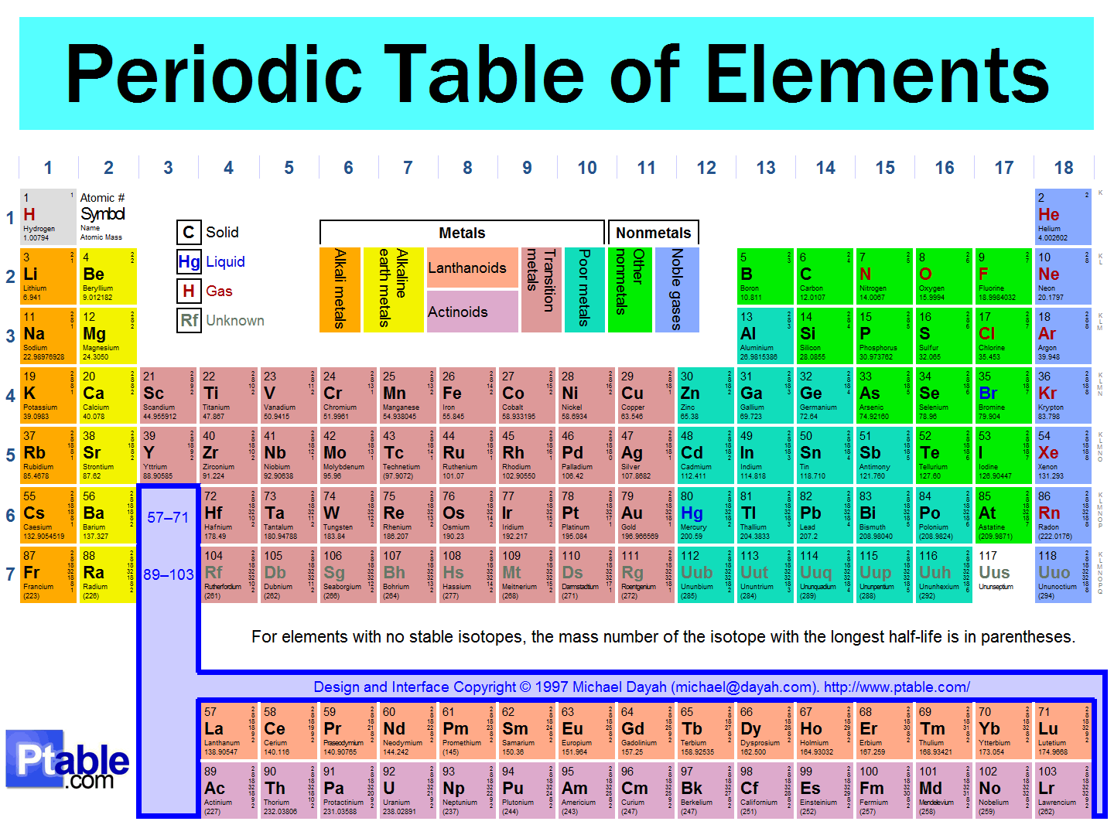
Notes:
Top upper left of chart = H for hydrogen

Slide 44
Science and the Age of the Earth
HYDROGEN IN THE UNIVERSE
Hydrogen is a chemical element with symbol H and atomic number 1 and is the lightest element on the periodic table.
Hydrogen is easily the most abundant chemical substance in the Universe.
It is found in the sun and most of the stars,
and the planet Jupiter is composed mostly of hydrogen. On Earth, hydrogen is found in the greatest quantities as water.
Notes:
H20 = two hydrogen atoms and one oxygen atom make water!

Slide 45
Science and the Age of the Earth
HYDROGEN IN THE UNIVERSE
Hydrogen is constantly being converted into helium throughout the Universe.
If the Universe were vastly old, there should now be little hydrogen left in it—since hydrogen constantly is being converted into helium, and this conversion is a one-way process.
Since the Universe consists chiefly of hydrogen, and there is no evidence of any new hydrogen being made, the concentration of hydrogen speaks of a young Universe.
Notes:
The Young Earth, by Bert Thompson, Ph.D.

Slide 46
Science and the Age of the Earth
Sir Fred Hoyle, the eminent British astronomer noted that….
“the universe consists almost entirely of hydrogen.” He therefore, was driven to conclude: “How comes it then that the universe consists almost entirely of hydrogen? If matter was infinitely old, this would be quite impossible.
So we can see that the universe being what
it is, the creation issue simply cannot be
dodged” (1960)
Notes:
The Young Earth, by Bert Thompson, Ph.D.
All the evidence points to a young earth!

Slide 47
Science and the Age of the Earth
These are just a few examples, and there are many other equally reliable scientific means, which indicate that the Earth is quite young.
After examining the evidence we have seen that both biblical and scientific evidences point to “the beginning” of our Universe as being just a few thousands of years ago!
The claims of evolutionists regarding a multi-billion-year-old Earth do not agree with much
of the actual Biblical or scientific evidence, which points to a young earth.
Notes:
The Young Earth, by Bert Thompson, Ph.D.

Slide 48
Science and the Age of the Earth
So is the earth young or old?
YOUNG!
One of the arguments made by those that believe in evolution is, “If the earth is so
young than why does it look so old?”
Notes:
The Young Earth, by Bert Thompson, Ph.D.
That is a good question! To help us explain that, we look to the doctrine of apparent age…

Slide 49
Science and the Age of the Earth
DOCTRINE OF APPARENT AGE
Someone may say, “You say the earth is young,
but the Earth looks so old!”
There are at least two responses that might
be made to such a statement.
First, you might ask, “Old, compared to what?”
or “What does a young Earth look like?
Second, we should not be surprised if certain dating methods in science appear to support
the idea of an ancient earth.
Notes:
From article, “The Doctrine of Apparent Age” by Bert Thompson, Ph.D.
When we say ‘young’ or ‘old’ what are we comparing it to?
Dating methods cause concern among many creationist, but it shouldn’t.

Slide 50
Science and the Age of the Earth
Why should we not be surprised that certain dating methods seem to support evolution?
The answer lies in what has been called the doctrine of apparent age.
This concept states that when God made
“heaven and earth, the sea, and all that is in them” (Exodus 20:11), they were made perfect, complete, full grown and ready for habitation by mankind along with all the different types of plant and animal life.
Notes:
From article, “The Doctrine of Apparent Age” by Bert Thompson, Ph.D.

Slide 51
Science and the Age of the Earth
The age old question is, “Which came first the chicken or the egg?”
God created the chicken full grown and ready
to lay her eggs!
Rather than creating an acorn and letting
it grow into a tree, God created a mature
mighty oak tree ready to produce acorns!
Rather than creating Adam and Eve as infants or young children, God created them as full grown adults ready to reproduce!
The Chicken!
Notes:
From article, “The Doctrine of Apparent Age” by Bert Thompson, Ph.D.
Which came first? The answer is the chicken!

Slide 52
Science and the Age of the Earth
How old were Adam and Eve two minutes after they were created?
They were two minutes old!
How old were the plants and animals two minutes after they were created?
They were two minutes old!
But the question we need to ask is, “How old
did the people, plants, and animals, who were only two minutes old, look like?
Much Older and Mature!
Notes:
From article, “The Doctrine of Apparent Age” by Bert Thompson, Ph.D.
This is the same for the rest of the universe!
This is important for us to know and remember!

Slide 53
Science and the Age of the Earth
It is important to realize that the initial creation had two ages;
1. literal age
2. apparent age.
The earth and everything in it may have literally just been one day old, two days old, three days old, and so on. But when looking at them they appeared to be much, much older.
Notes:
From article, “The Doctrine of Apparent Age” by Bert Thompson, Ph.D.
Even the dating methods science uses today would have shown the earth the be a lot older than it actually was!
Here is something interesting…

Slide 54
Science and the Age of the Earth
The biblical record provides us with additional information concerning the accuracy of the doctrine of apparent age.
In Genesis 1:14, God told Moses that the heavenly bodies (e.g., Sun, Moon, stars) were
to be for signs and for seasons, for days and
for years. In order for them to be useful to man for the purpose of signs, seasons, days, and years, these heavenly bodies must have been visible to mankind from the very beginning of Creation!
Notes:
From article, “The Doctrine of Apparent Age” by Bert Thompson, Ph.D.

Slide 55
Science and the Age of the Earth
When Adam and Eve looked up into the night sky it was not totally dark because when God created the heavenly bodies He made their light already visible from Earth!
There was a specific purpose behind God's mature creation. It had to be ready and fully functional so that Adam and Eve could use it
to its fullest potential from the very beginning!
“The heavens declare the glory of God, and the firmament shows His handiwork.” Psalms 19:1
Notes:
From article, “The Doctrine of Apparent Age” by Bert Thompson, Ph.D.
Notice these Old Testament passages that speak about God creating the universe with the sun, moon and stars!

Slide 56
Science and the Age of the Earth
“You alone are the Lord. You made the heavens, even the highest heavens, and all their starry host, the earth and all that is on it, the seas and all that is in them. You give life to everything, and the multitudes of heaven worship you.”
Nehemiah 9:6
“This is what the Lord says, He who appoints the sun to shine by day, Who decrees the moon and stars to shine by night, Who stirs up the sea so that its waves roar—the Lord Almighty is His name.” Jeremiah 31:35

Slide 57
Science and the Age of the Earth
“By the word of the Lord the heavens were made, their starry host by the breath of His mouth. He gathers the waters of the sea into a heap, He puts the deep into storehouses. Let all the earth fear the Lord; let all the people of the world revere Him. For He spoke, and it came to be; He commanded, and it stood firm.”
Psalms 33:6-9

Slide 58
Science and the Age of the Earth
“To him who alone does great wonders, His love endures forever. who by his understanding made the heavens, His love endures forever. Who spread out the earth upon the waters,
His love endures forever. Who made the great lights, His love endures forever. The sun to govern the day, His love endures forever. The moon and stars to govern the night; His love endures forever.” Psalms 136:4-9
God truly is the creator of everything!
Notes:
Evolutionist are not content to believe that God created the universe. They come up with all kinds of theories to try and prove that the world is billions of years old when the Bible clearly shows that it is just thousands of years old!

Slide 59
Science and the Age of the Earth
One argument that evolutionary scientists try
to use to prove an old earth is starlight.
The argument goes something like this… We understand that light travels at a speed slightly more than 186,000 miles per second. (The time it takes light to travel one year is referred to as
a light-year, 6 trillion miles) Yet, we are able to see light from stars that are multiplied millions
of light-years away.
How can this be if the Earth is only 6,000 years old as creationists suggest?
Notes:
From article, “The Doctrine of Apparent Age” by Bert Thompson, Ph.D.
Light traveling from the moon to the earth takes only 1.3 seconds! (moon is 240,000 miles away)
Light traveling from the sun to earth takes 8 minutes 20 seconds! (sun is 93 million miles away)

Slide 60
Science and the Age of the Earth
That is a good question!
Today, we can look out into space and see millions of light years to other stars, galaxies and constellations.
The Hubble telescope that was launched into earths orbit on April 24, 1990 has provided us with beautiful pictures of our universe never before seen by mankind!
Notes:
From article, “The Doctrine of Apparent Age” by Bert Thompson, Ph.D.
The Hubble Space Telescope was named after astronomer Edwin Powell Hubble (1889–1953), who made some of the most important discoveries in modern astronomy.
Hubble revolutionized the field of astrophysics. His research helped prove that the universe is expanding, and he created a classification system for galaxies that has been used for several decades.
Did you know that he was born on November 20, 1889, in Marshfield, Missouri?
Notice this picture of the Hubble telescope and some pictures it has taken of space….

Slide 61
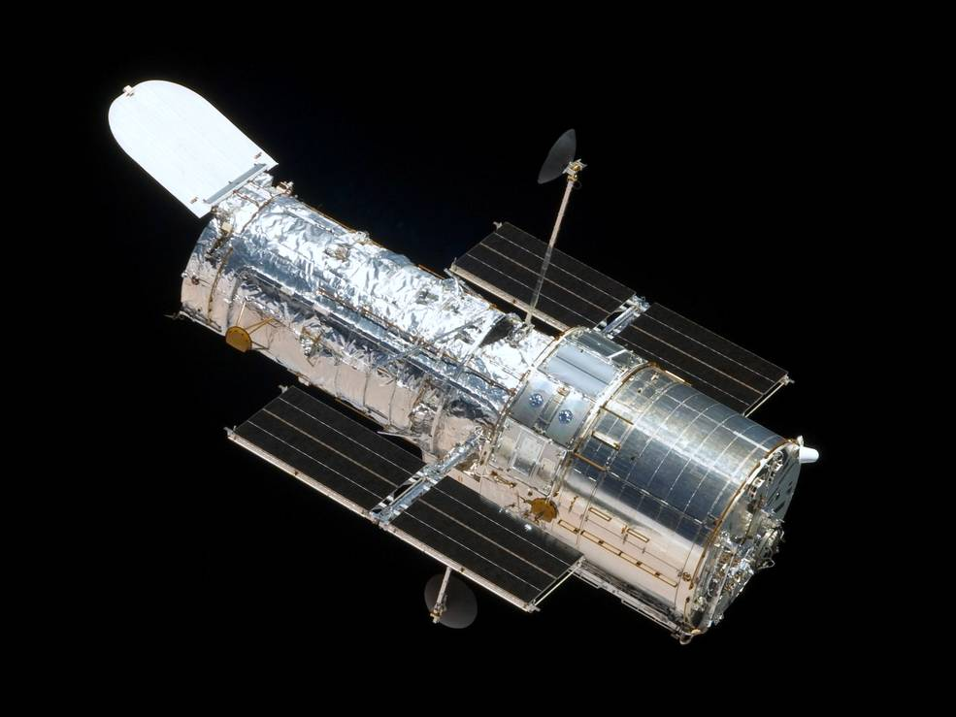
Notes:
The Hubble Telescope. Here are some pictures that the Hubble Telescope has taken.

Slide 62
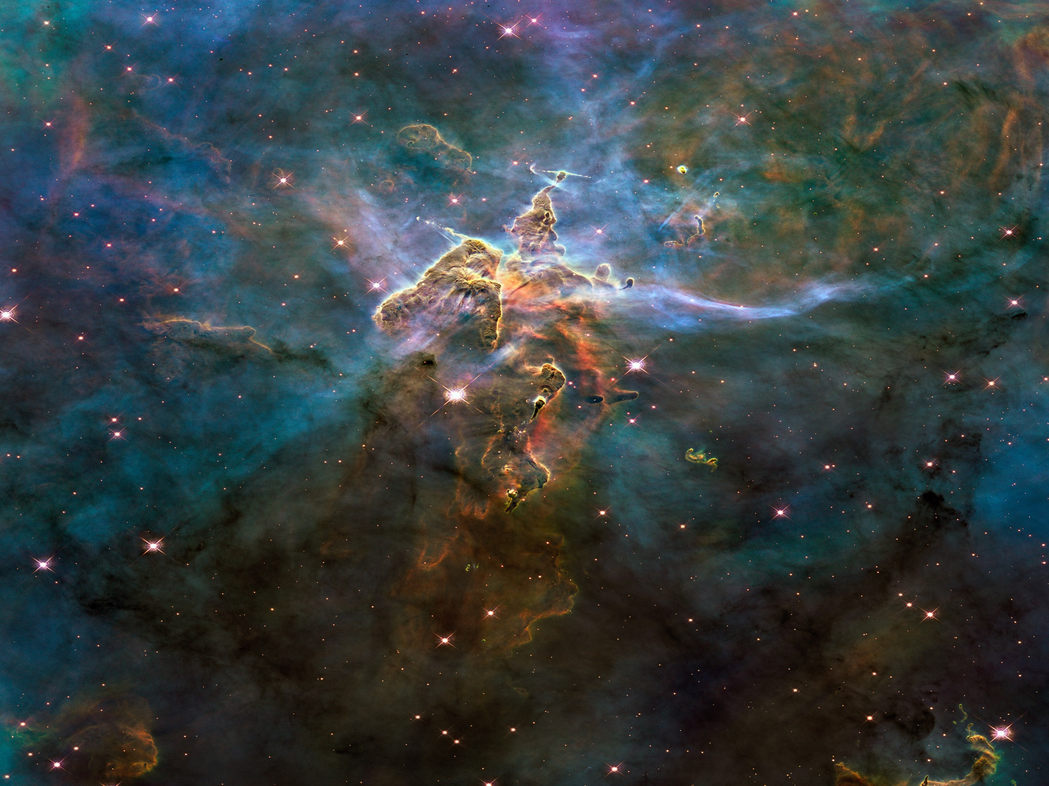

Slide 63
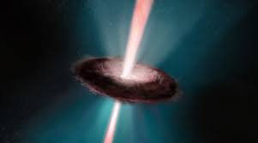

Slide 64
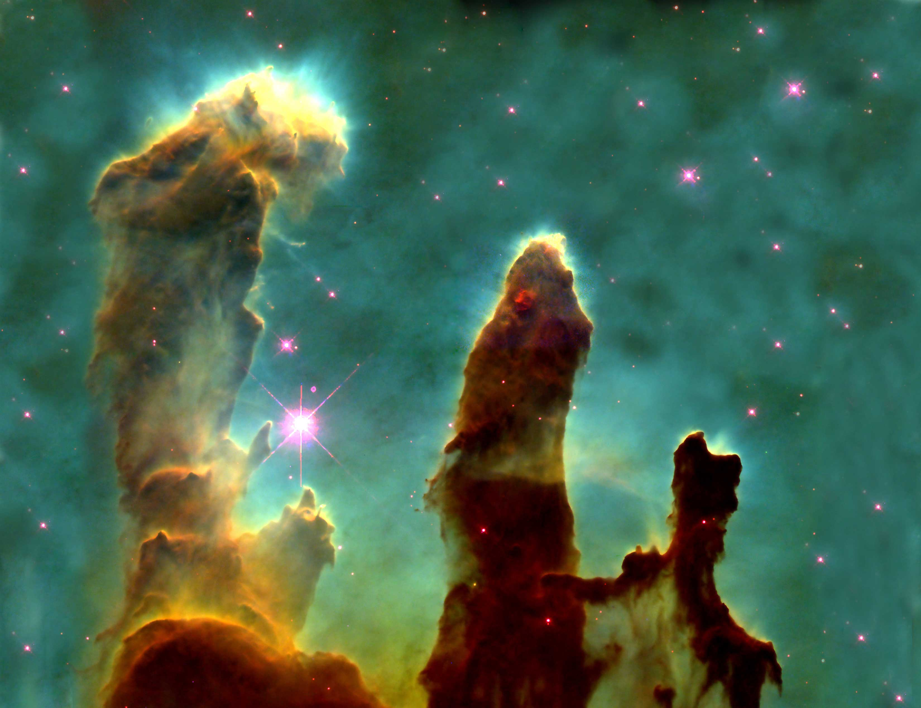

Slide 65
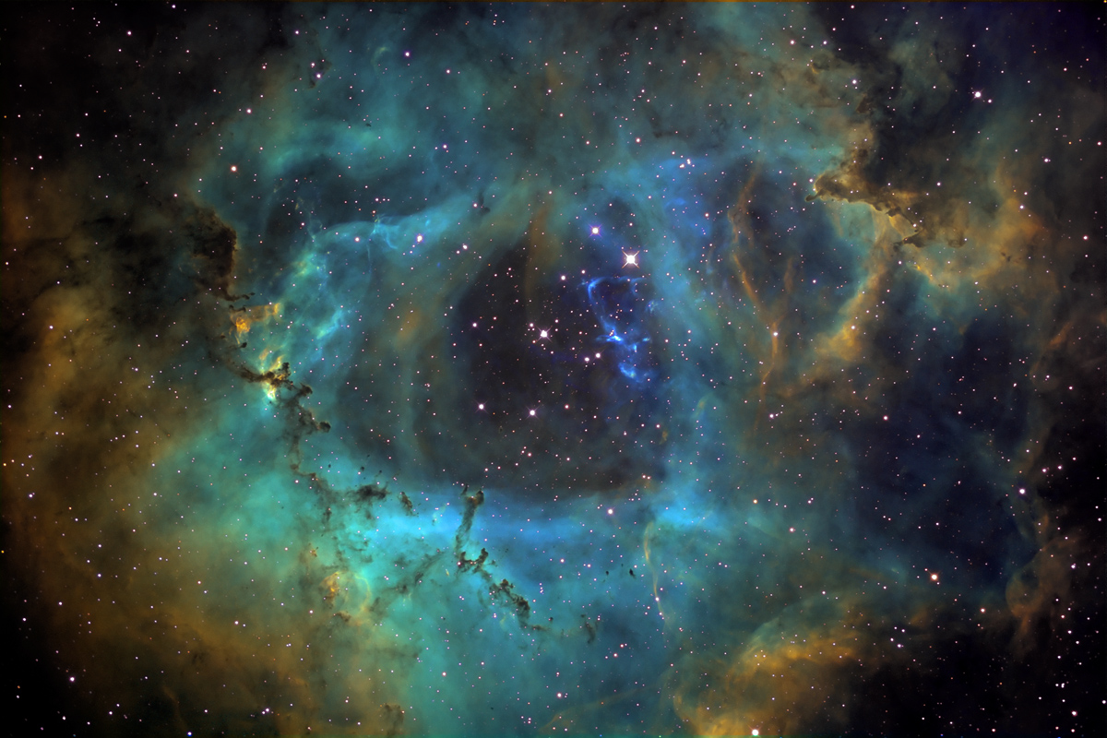

Slide 66
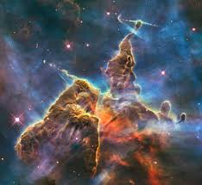

Slide 67
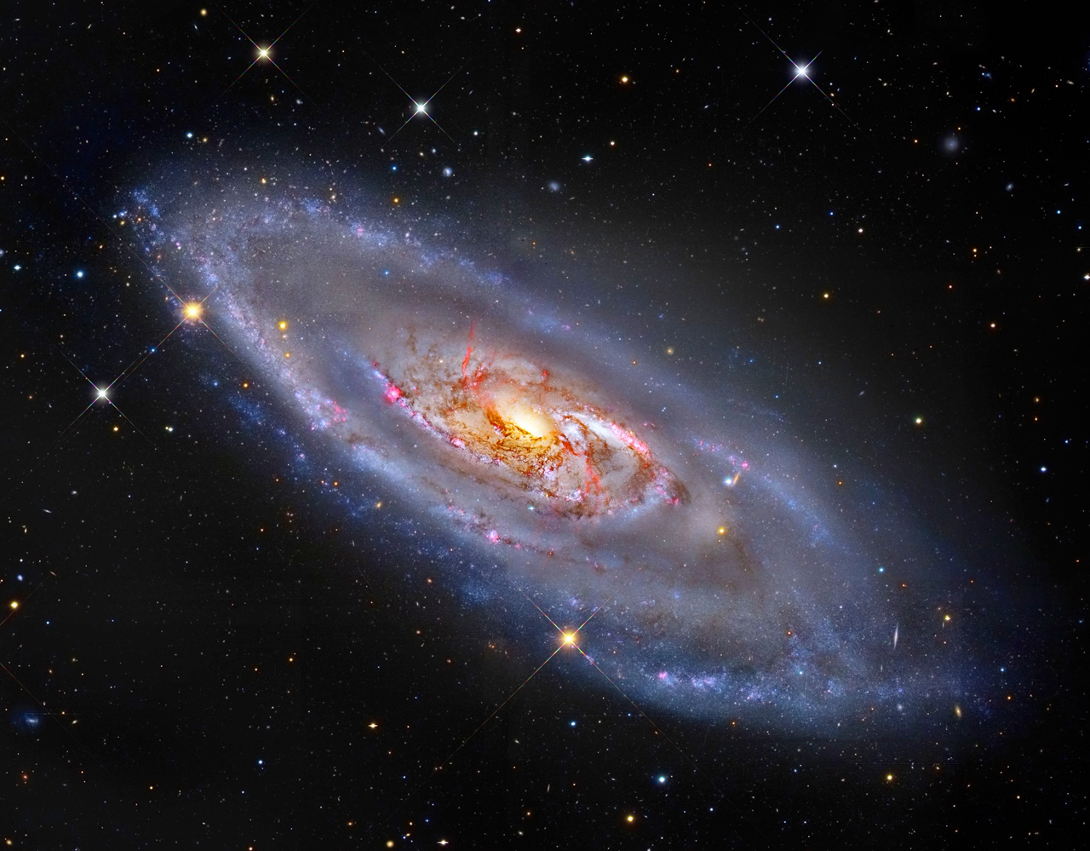

Slide 68
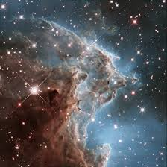

Slide 69
Science and the Age of the Earth
These pictures give us just a glimpse of the beautiful universe in which we live and that
God created for us!
Mankind, in times past was not able to see the universe the way we can see it today with the technology we have.
Yet, they were able to see the many stars in the sky at night that came from galaxies that are many millions of light years away, how can that be?
Notes:
From article, “The Doctrine of Apparent Age” by Bert Thompson, Ph.D.

Slide 70
Science and the Age of the Earth
God was able to do this by creating the heavens and the earth and creating light from heavenly bodies already visible to the Earth's inhabitants at the moment they were created!
Remember, the universe was created mature!
Without such light, the night sky would lack patterns necessary to serve as signs, seasons, days, and years specified so clearly in Genesis 1:14, and mankind would have been unable to see God's glory and handiwork.” (Psalm 19:1)
Notes:
From article, “The Doctrine of Apparent Age” by Bert Thompson, Ph.D.

Slide 71
Science and the Age of the Earth
We noted earlier that there are two ages to the universe…
1. literal age
2. apparent age
The mighty Redwood trees in California, though two minutes old (literal age) looked like they were hundreds of years old! (apparent age)
Adam and Eve in the Garden, though two minutes old (literal age) looked like they were 30-60 years old! (apparent age)
Notes:
Today, the earth is about 6,000 years old but it looks like it has been here for millions or billions of years. That is why the evolutionary scientists are confused. They are just using the evidence around them and not taking into account God’s Word!
At the end of the Creation week the earth looked very old and any test you could use would also show it to be very old when in fact it was just one week old!

Slide 72
Science and the Age of the Earth
The same can be said about starlight.
How many have seen the North star?
Did you know that the North star is 434 light years away from earth?
That means the light you see tonight left the star 434 years ago! (in 1584 A.D.)
If the star burned out tonight, we on earth would not know it for 434 years! (in 2452 A.D.)
Notes:
The light you see from the North star tonight left the star in 1582! (based on the year being 2018)
Earth would not know star burned out until 2450! (based on the year being 2018)

Slide 73
Science and the Age of the Earth
Yet, Adam and Eve, when they were only two minutes old, would have been able to see the North Star, though it was 434 light years away!
That is why the light from stars, suns and galaxies that are millions of light years away
can be seen on earth today though the earth
is only a few thousand years old!
This concept is important to remember when dealing with scientific evidence that seems to show an old universe!

Slide 74
Science and the Age of the Earth
If you were able to cut down one of the mighty Redwood trees two minutes after it was created, and counted the rings to find its age, what would you find?
Hundreds of tree rings! Just like it had actually grown for hundreds of years!
This is why the dating methods that scientists use to try and date the earth and the universe are not reliable!

Slide 75
Science and the Age of the Earth
If scientists used their dating methods to determine the age of the earth or the universe two minutes after creation, what would it tell them?
Would their methods be accurate and tell them they were only two minutes old?
No, it would give them measurements showing hundreds, thousands, millions or billions of years depending on what they measured because God created everything fully grown and mature!

Slide 76
Science and the Age of the Earth
The dating methods used by scientist cannot be trusted much past a few thousand years.
Something else that scientist fail to consider when trying to find the age of the earth is the global flood of Noah, especially when dealing with geology.
We will talk more about this in our next lesson on the flood of Noah!

Slide 77
Science and the Age of the Earth
The doctrine of apparent age not only explains many of the alleged evidences that evolutionist point to as proof that the Earth is ancient, but it
is also entirely scriptural in its foundation!
It also helps to answer many of the questions relating to the concept of a planet that looks
to be of great age but in reality is only a few thousand years old!
Notes:
From article, “The Doctrine of Apparent Age” by Bert Thompson, Ph.D.

Slide 78
Science and the Age of the Earth
Don’t be fooled by what evolutionary scientists tell you!
The Universe and the Earth are not billions of years old!
True science, and the Bible, tells us that the Universe and the earth are young and are literally just a few…
Thousands of Years Old!
Notes:
From article, “The Doctrine of Apparent Age” by Bert Thompson, Ph.D.

Slide 80
Creation vs. Evolution
By Bob Gard – Hollister, Missouri church of Christ
www.hollistermocofc.org
Dec. 27, 2017 to Jan. 17, 2018

